Slide 1
Tushauriane
Tushauriane Mental Health application

Slide 2
Cynthia Wanja(It specialist)
La’desha Mitchelle-SE(software engineer)

Slide 3
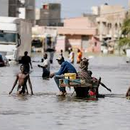
Problem statement
Floods have emerged as a significant concern within our country, not only causing physical devastation but also deeply impacting the mental well-being of affected individuals. The loss of homes and livelihoods, coupled with ongoing rains and widespread damage to infrastructure, has led to immense human suffering.

Slide 4
solution
Given the financial constraints that many face in accessing professional mental health support, we came up with the idea to create an online application tailored to aid flood victims, completely free of charge.
Our innovative mental health website aims to bridge this gap, providing an accessible online platform offering culturally-relevant mental health resources and support to all Kenyans impacted by natural disasters like these floods. Leveraging technology allows us to reach those in need across the 70% of the rural population, providing vital tools and services to aid resilience and emotional recovery during crises when nearly 1 in 5 individuals requires mental health assistance.

Slide 5
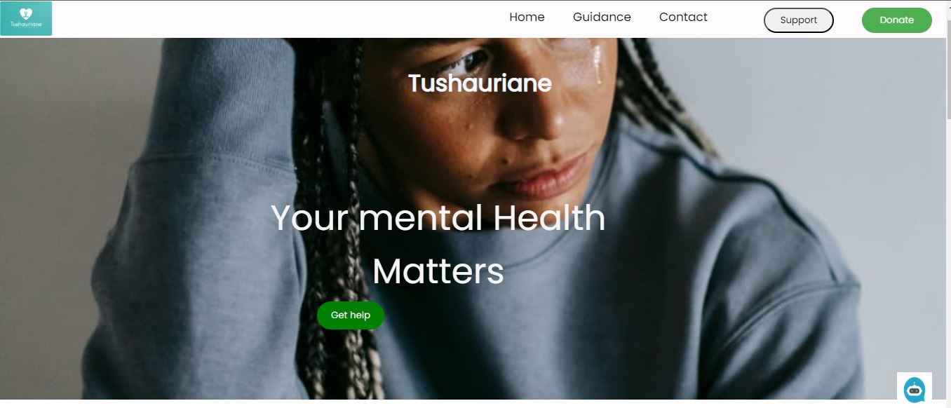
Landing page the Homepage of the application

Slide 6
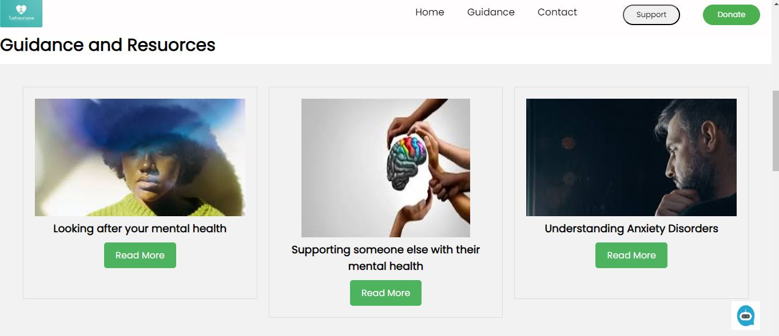
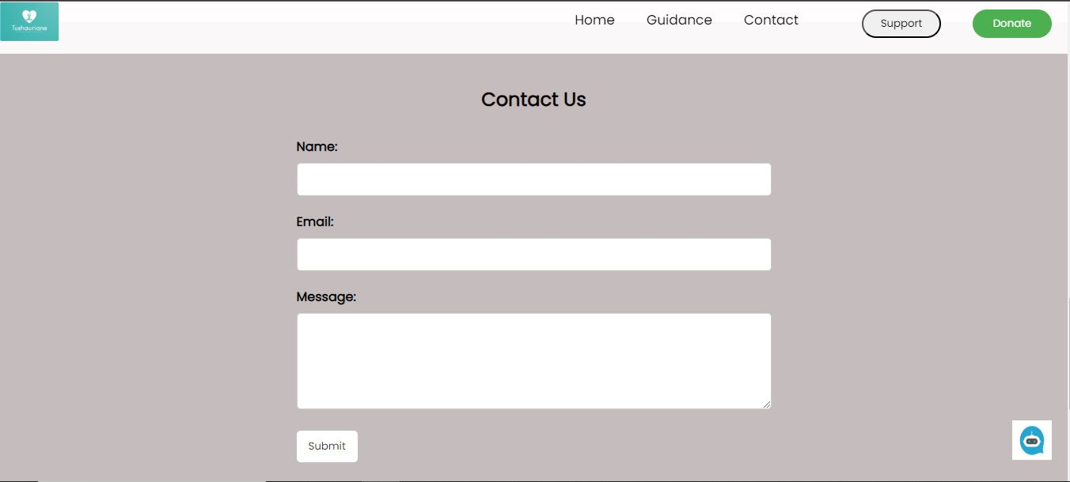
Resources that a user will use
Contact page for easy communication with the organization

Slide 7
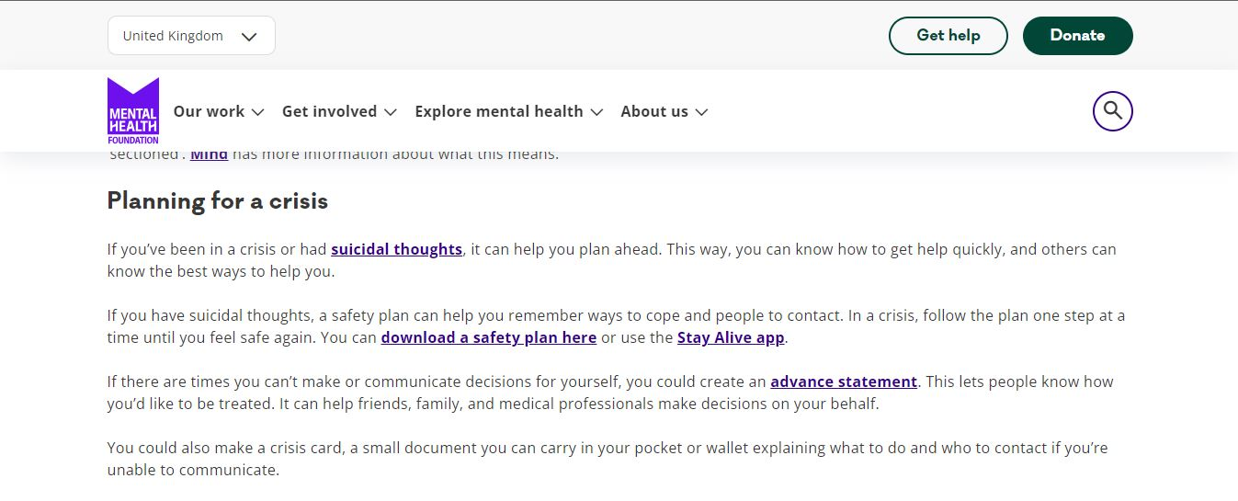
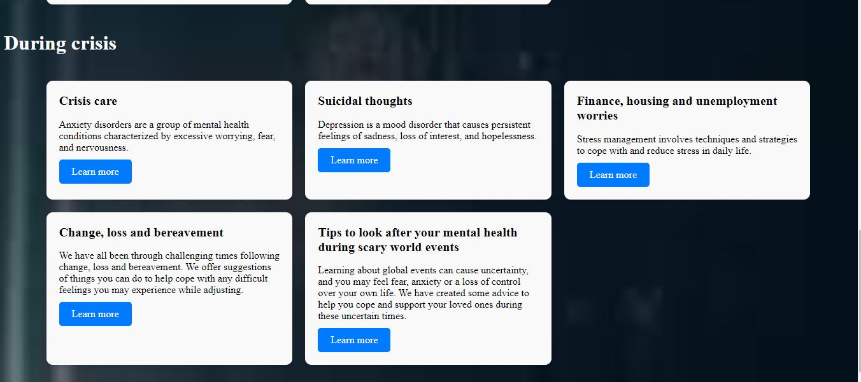
Articles

Slide 8
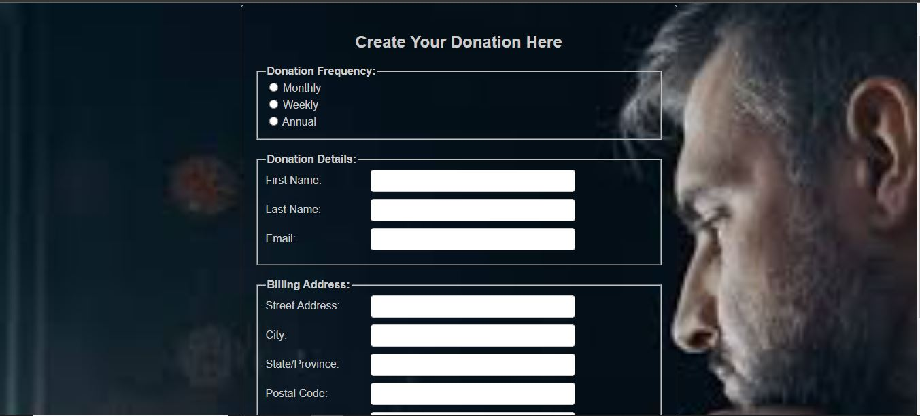
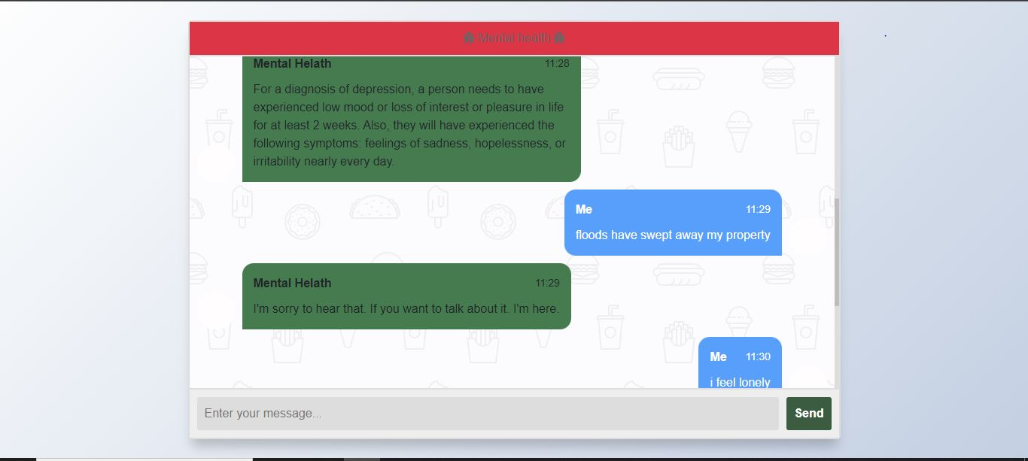
Donors form
Mental health chatbot

Slide 9
Impact
Reduced financial burden on individuals seeking mental health assistance.
Minimized expenses associated with travel to access mental health services.
Lowered healthcare costs for communities and governments in the long term.
Empowerment of individuals to take control of their mental health.
Reduced stigma surrounding seeking help for mental health issues.

Slide 10
THANK YOU!

